Slide 1
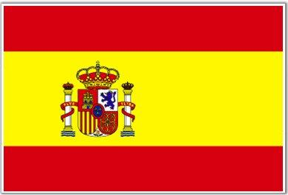
Spanish Flag

Slide 2
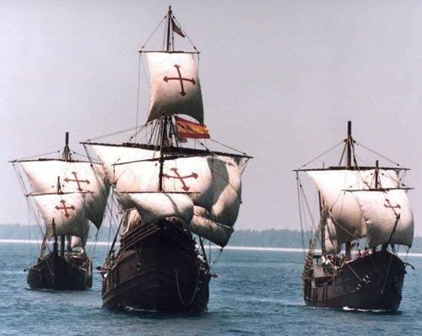
Spanish Armada

Slide 3
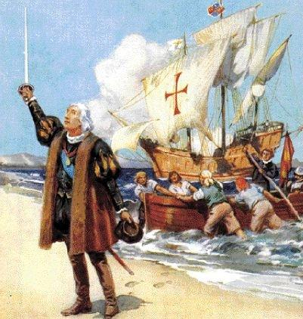
Christopher Columbus

Slide 4
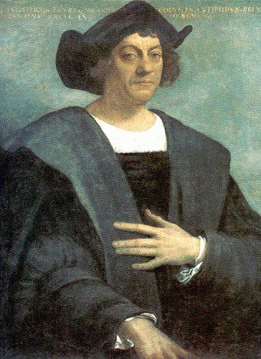
Christopher Columbus

Slide 5
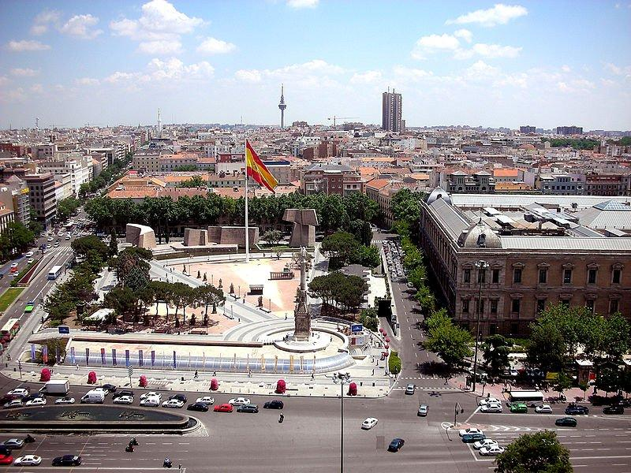
Plaza De Colon

Slide 6
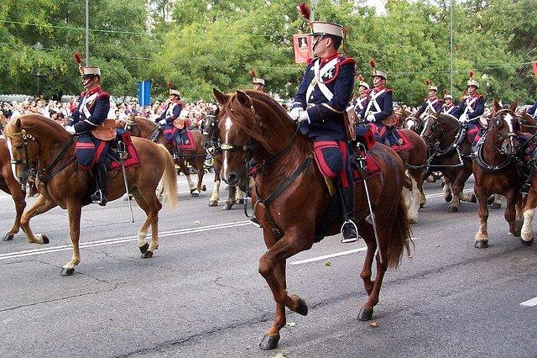
Guard on Horse

Slide 7
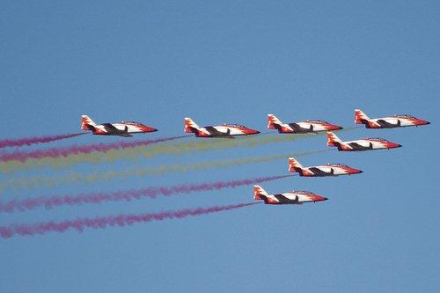
Festival Aerial Show

Slide 8
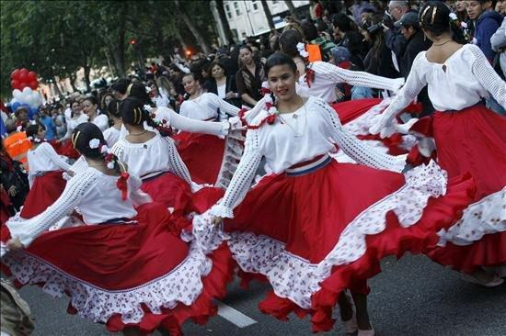
Dancers at Dia de La Hispanidad

Slide 9
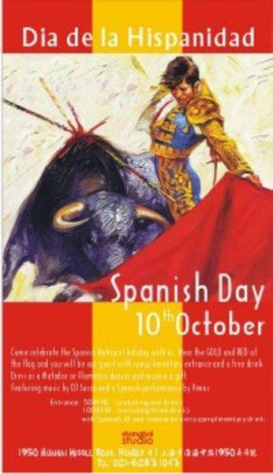
Festival

